Slide 1
Study for Success in S.T.E.M. Courses
Dr. Robert F. Gessner
Professor of Biology – Valencia College

Slide 2

The first two years for a S.T.E.M. major are critical to your success!

Slide 3
S.T.E.M. courses are sequential.
S.T.E.M. majors cannot procrastinate!
The first step in succeeding in a S.T.E.M. course happens before you even sign up for the class.

Slide 4
Before your sign up for a S.T.E.M. class, you need to determine whether you have enough time to devote to the class.

Slide 5


In my opinion, success in college is proportional to your ability to organize your time and plan in advance.

Slide 6

Unless you can remember everything, you need to use a calendar to manage your time.

Slide 7
Let’s practice.
Let’s imagine your classes start today and you have:
Freshman Composition on M,W from 10 – 11:15 a.m. Intermediate Algebra on T,R from 2:30 – 3:45 p.m.
N.S.E. on M,W from 11:30 a.m. – 12:45 p.m.
Latin American Humanities on T, R from 10 – 11:15 a.m.
Schedule your time for this week.

Slide 8
What do you need to account for in your planner?
- class time
- every assignment/test, registration and tuition due date
- study time alone, with your professor during office hours, with a tutor or study group
- do you work?
- when do you plan to eat?
- when do you work out?
- when do you plan on relaxing and sleeping?
- how much time does it take for you to get ready in the morning and travel to school?
- when do you plan to spend time with your family?
- do you schedule reward time?

Slide 9
Find a calendar that works for you; it can be a paper calendar or one on your cell phone or computer, but use a calendar.
To begin using your calendar, read your course syllabus and enter the due dates of every assignment from the first day of class to the final exam.

Slide 10
A typical science class, with a lab, is worth 4 credit hours, but has 6 contact hours per week.
- That means you should expect to spend at least 12 hours/week studying.
- One major reason students do not succeed in science classes is they don’t have time to devote to a thorough understanding of the material in the class.
- You should look at your other time commitments to determine when you should take your science classes.

Slide 11

Time Management Tips

Slide 12


Use your planner every night to plan your next day and revisit your planner in the morning to get your day off to a good start with a to-do list.

Slide 13
For assignments and assessments that you anticipate need a long term investment of time, plan backwards, break them into small goals and to be sure you allot enough time to finish.

Slide 14
Know the attendance policies of your professors and record any absences on your calendar.
(HINT: Missing class should be a rarity!)
Add time in your planner to allow for the unexpected; plan for some flexibility, and NEVER CRAM.
Your college education is an investment and can determine the future of not only yourself, but also of your family; what are your priorities?

Slide 15
Once you have determined that you have the ability to devote the necessary time to studying for a class, how do you determine the best professor for you?

Slide 16
1) References from your peers.
2) References from your professors.
3) myedu.com (How should you use grade distribution reports?)
4) Ratemyprofessor.com (How should do you use these reports?)
SIGN UP FOR YOUR CLASSES AS SOON AS YOU ARE ALLOWED TO REGISTER; this will enable you to get the best selection of classes.

Slide 17
When choosing a professor, it can also help to know what type of learner you are: a) Visual* b) Kinesthetic* c) Verbal* d) Reflective e) Gustatory f) Factual/linear g) Theoretical/global

Slide 18
Many people have multiple learning styles, and your professor may not teach to your learning style strengths. The trick is to maximize the skills you use with your own learning style while working to become better at other learning styles.

Slide 19
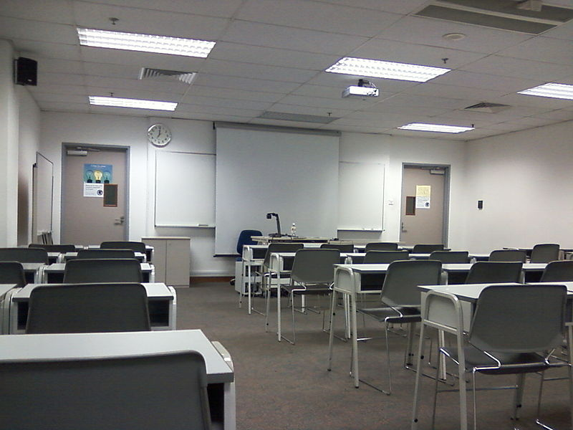
THE FIRST DAY OF CLASS

Slide 20
Either before or on the first day of classes, READ THE SYLLABUS!
(The syllabus is your course contract.)
- Don’t sit in the back of the class.
- Don’t sit near windows or doors.
- Don’t sit with your friends.
- Sit where you can see and hear the professor.
- Make sure you are on time to every class.

Slide 21
Learning is an action verb, you have to do more than sit through classes (passive) and reread the notes (passive) to do well in science classes.
Simply rereading your notes over and over is not studying!!

Slide 22
If you can’t teach someone the concept you are learning, you don’t know it.

Slide 23

So how do you study?

Slide 24
Read the materials that will be covered in class BEFORE THE CLASS MEETS and right before class, do a quick review of the material you recently covered.

Slide 25
If your professor allows, tape record the class and within 24 hours of a class, rewrite your notes.
After that, every day, read over each difficult concept in your notes, put away your notes and write as much as you can remember from memory. Check to see what you knew and what you didn’t know. Do that every day for each difficult concept until you can teach someone else about the subject.

Slide 26

Use flashcards
1) For vocabulary words
2) To predict questions and answers on tests
3) To remember lab concepts

Slide 27
Use mnemonic devices, make up songs and rhymes to remember concepts.
Know root words, prefixes and suffixes; they are a major key to understanding the language of science.

Slide 28
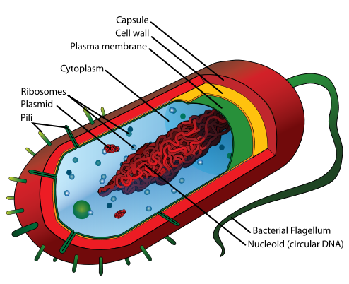
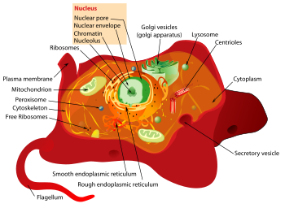
How do you remember the difference between Prokaryotes vs. Eukaryotes?

Slide 29
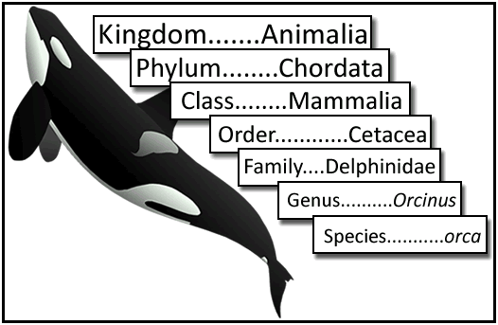
How do you remember these levels of classification?

Slide 30
Make connections between the concepts you are learning.
Compare and contrast concepts.
For many students, making a chart or table works to put the concepts you learn into an organized format to recall information.

Slide 31
Make lists of topics that you don’t understand and:
1) go see your professor and ask questions during office hours or in class
2) join a study group and exchange phone numbers or use social media
3) go to an on-campus tutoring center or use Smarthinking tutoring services
4) go online to Google definitions and concepts and go to Google Images
5) go to khanacademy.org or watch You Tube videos

Slide 32
For labs, read the materials before lab. After each lab, make a journal which answers 4 questions:
1) What did you use in each lab?
2) What did you do (the procedures) in each lab?
3) What did you see in each lab (the results)?
4) Why did you see what you saw in each lab (explain why the results turned out as they did)?
Every day, for each lab, write the answers to each of these questions from memory, until you no longer have to refer back to the journal to recall the answers.

Slide 33
- If you can, relate what you are learning to things you already know.
- Study with a purpose. Make lists of questions and try to answer the questions from recall.
- Science reading isn’t like reading a novel; you must understand every word in a sentence before you can go on to the next sentence.
If you don’t know a word in a sentence,
LOOK IT UP.

Slide 34

What about your study environment?

Slide 35
1) Make studying a habit at a certain place and time of the day
2) Your study area needs to be organized and free of distractions
3) Limit the chance for interruptions
4) Don’t study when you are hungry or full
5) Don’t study if you are tired
6) Don’t study if you are stressed out
(Baycare Behavioral Health’s confidential student assistance program is for you: (800) 878-5470)

Slide 36
Break study time into “chunks” of time.
If you have other things on your mind or begin to daydream, stand up and walk around for 10 seconds, let your mind wander and then return to your studies.
Vary study activities: read a little, write a little, speak a little

Slide 37

TEST TAKING

Slide 38
1) Each question should be read slowly and carefully, looking for key words.
2) Answer the easier questions first and then come back to answer those you find more difficult; other questions may have hints that will jog your memory.
3) Change multiple choice answers at your peril; usually your first response is right.
4) Eliminate as many answers as possible if you are stuck on a multiple choice question, then guess if you must.
5) Be aware of the time and go through higher point value questions first.
6) For essay questions, use specific words and not words like “it”, “those” and “things”.
7) Learn to spell your new vocabulary words; in medicine, a minor misspelling can mean the difference between life and death.

Slide 39
Learning in the S.T.E.M. fields is like learning a new language.
To learn languages, you need to immerse yourself in the “culture” and speak and write the language often.

Slide 40
Remember, your college classes are an investment in your future. It is critical that you learn for long-term memory and not cram for tests and quizzes.
The exams you take will be on materials that are not covered verbatim from the lectures or your textbooks.
Each successive science class builds upon the knowledge from the previous classes and you will be expected to know the information you learned from previous classes.

Slide 41
HAVE YOU EVER JOB SHADOWED, VOLUNTEERED, OR INTERNED in the job that you one day hope to have?
IF NOT, YOU COULD BE IN FOR A BIG SURPRISE!!!
(one which you may not like)
CONSULT WITH A CAREER PROGRAM ADVISOR and the
INTERNSHIP AND WORKFORCE SERVICES OFFICE.

Slide 42


Studying can be done the right way or the wrong way; ultimately, your success depends upon you. Which emotion do you want to feel at the end of each course?

Slide 43
How do people become successful?
Is it due to good luck?

Slide 44
What if something goes wrong and you stumble along the way?
Do you know the student withdrawal date?
(HINT: It should be in your planner)

Slide 45
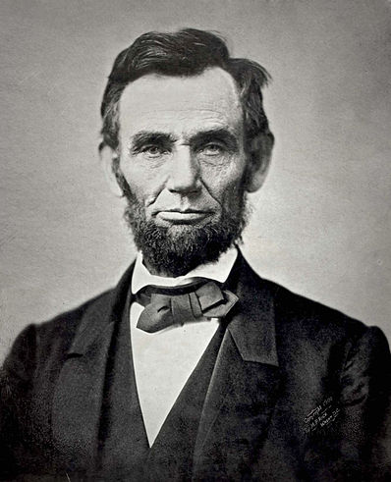
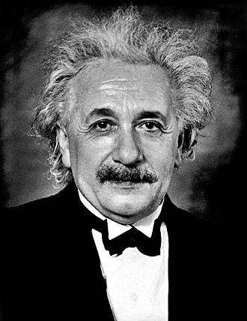
Successful people don’t give up!

Slide 46


Successful people don’t make excuses,

Slide 47


even when they come from the humblest beginnings,

Slide 48
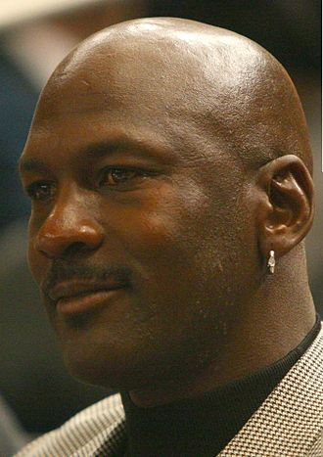

they keep trying.

Slide 49
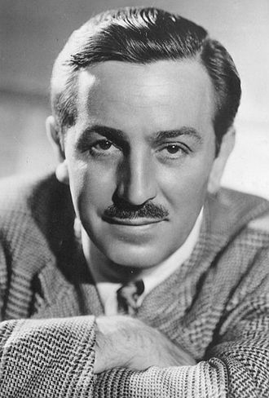
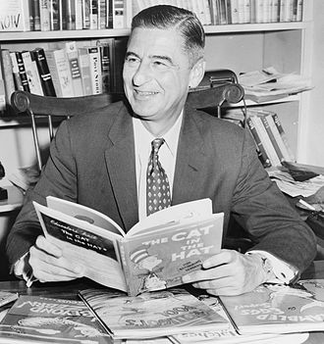
Their peers said they couldn’t do it,

Slide 50
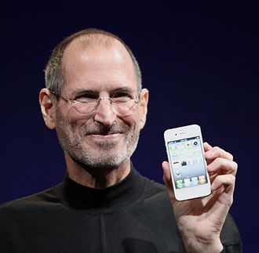
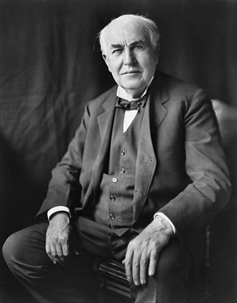
but they keep plugging along.

Slide 51
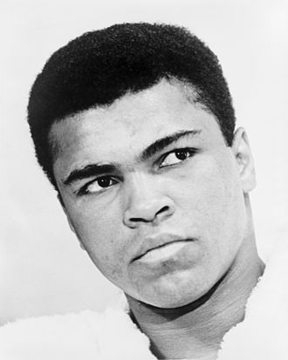
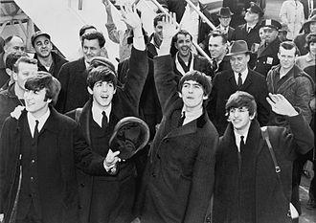
So do your best and give yourself a chance. It’s your dream; go live it!

Slide 52
QUESTIONS?
This PowerPoint presentation can be found on Dr. Gessner’s Faculty FrontDoor website.
Go to the Valencia College homepage, Current Students, Faculty Websites and find my website. Under Course Materials, you can find this presentation.

